Slide 1
National Transportation Safety Board
Truck and Bus Safety Forum
May 10 - 11, 2011

Slide 2
Industry Facts
The US Commercial Bus Industry currently carries more than 750 million passengers annually. This is more passengers than US domestic aviation and Amtrak combined.
US commercial bus transportation is one of the nation’s safest forms of passenger transportation.
Catastrophic bus and motorcoach crashes are still relatively rare events; however, passenger and driver fatalities have been on the increase over the past 10 years.
Prior to 1999, passenger and driver averaged between 6 – 10 deaths per year and had remain relatively steady for over twenty years.
From 1999 - 2009 and driver fatalities steadily started to increase to an annual average of 25 deaths .
.From 2009 through 2011 there has been an annual reduction of bus crash fatalities. The BISC believes this is primarily due to a greatly increased enforcement effort at the federal and state level.
The bus industry believes even one fatality per year is too many and we further believe that a fatality free year is achievable.
Bus Industry Safety Council [BISC] is appealing to all safety and enforcement organizations to help us in preventing serious bus accidents.

Slide 3
A Bus Industry Appeal For A “Zero Tolerance”
Enforcement Campaign Against Unsafe Bus Drivers
The following list of fatal bus crashes by unsafe or illegal passenger carriers highlights the consequences of not shutting down unsafe or illegal commercial bus companies before tragedy strikes.
These are the types of events that ABA and the BISC, working in conjunction with the FMCSA and our state safety partners, are working to prevent.
All of these tragedies were preventable.

Slide 4
The following passenger carriers were identified post crash as having significant safety management problems or were operating illegally.
These companies were responsible for the deaths of 133 passengers and drivers from 1999 through 2008.
These crashes represent 22% of all fatal motorcoach crashes through that timeframe.
These 15 passenger carriers accounted for 54% of all fatalities.
New Orleans, Louisiana – Mothers Day 1999 – 22 killed UNSAFE CARRIER
Sussex, New Brunswick, Canada – 2001 – 4 killed UNSAFE CARRIER
Terrell Texas – 2002 – 5 killed UNSAFE CARRIER
Salt Lake City, Utah – 2002 – 6 killed UNSAFE CARRIER
Hampshire, Illinois – 2003 – 8 killed ILLEGAL CARRIER
Tallulah, Louisiana – 2003 – 8 killed ILLEGAL CARRIER
Marion, Arkansas – 2004 – 14 killed UNSAFE CARRIER
Hutchins, Texas – 2005 – 23 killed UNSAFE CARRIER
Atlanta, Georgia – 2007 – 7 killed UNSAFE CARRIER
Clearfield, Pennsylvania – 2007 – 2 killed UNSAFE CARRIER
Bowling Green, KY – 2007 – 2 killed UNSAFE CARRIER
Forest City, Arkansas – 2007 – 4 killed UNSAFE CARRIER
Victoria, Texas – 2008 – 2008 – 1 killed ILLEGAL CARRIER
Sherman, Texas – 2008 – 17 killed ILLEGAL CARRIER
Colusa County, California – 2008 – 10 killed ILLEGAL CARRIER

Slide 5
Give Them No Place To Hide
The American Bus Association and the Bus Industry Safety Council have identified 6 key issues that, if implemented or improved, will make it difficult for bus companies or bus drivers to knowingly and willfully evade safety compliance.
More Moving Violation Enforcement
Consistent State Bus Inspection Programs
Passenger Endorsement Background Checks Should Identical to Hazardous Material Background Checks
Verification That Out-Of-Service Orders Are Being Obeyed Within 5 Working Days of Issuance
Visit Any Passenger Carrier That Has An SMS “Alert” Within 5 Working Days
Separate Passenger Carriers From The FMCSA Carrier Database And Make Consumer Identification of Safe Carriers Easier

Slide 6
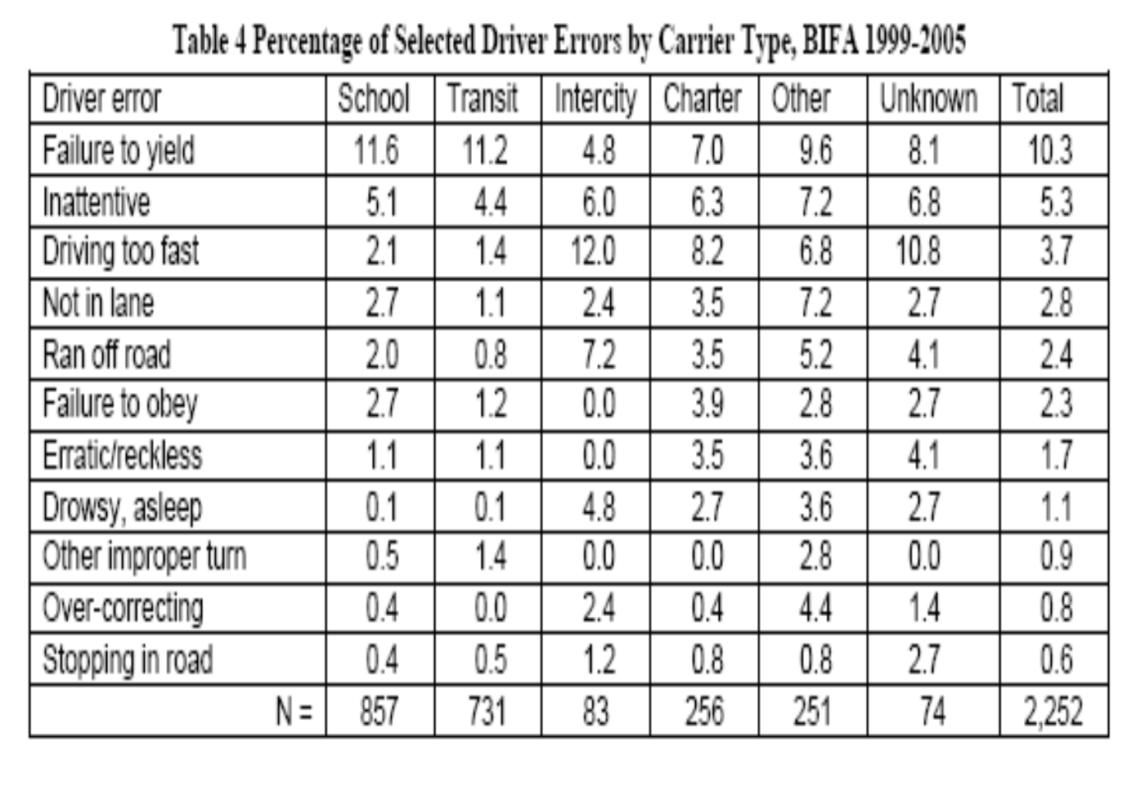
More Moving Violation Enforcement
Data produced by the Large Truck Crash Causation Study and from the June 2008 University of Michigan Transportation Institute study of “Bus Operator Types and Driver Factors in Fatal Bus Crashes: Results from the Buses Involved in Fatal Accidents Survey”, indicates that driver actions and/or inactions account for most fatal bus crashes. These data further indicate that certain types of dangerous driving behavior are good indicator of the likelihood of a driver being involved in a future crash.

Slide 7
Zero Tolerance For Serious Moving Violations
When a bus or motorcoach is observed being operated in an unsafe fashion any enforcement officer, not jus motor carrier enforcement officers, should pull the bus over in safe location.
The officer explains to passengers that he/she needs to speak with the driver and that the bus will be on the way shortly. Take the driver off the bus and issue a citation if appropriate.
When a citation is issued the officer should be present on the citation court date to press the charge.
Appeal to the court not to reduce or mask the charge since this action allows unsafe drivers to continue to operate and endanger the public.
We need to hold bus drivers to similar safety performance standard as airline pilots. They are tasked with identical “great care” duties and responsibilities to the traveling public.

Slide 8
Consistent State Bus Inspection Programs
All states need to have consistently stringent bus inspection programs. This is currently not the case. In instances where a state is unable to conduct a comprehensive and robust bus inspection program, the FMCSA should step in with federal inspectors or qualified third-party inspector. This option could be paid for using a proportionate amount of the subject state’s MCSAP funds.
Strong state inspection programs are key component in the elimination of unsafe or illegal passenger carriers. Passenger pick-up points or destinations should be the favored inspection point since bad carriers simply avoid roadside inspection by detouring around them.

Slide 9
Passenger Endorsement Background Checks Should Identical to Hazardous Material Background Checks
All motor carriers depend on the state licensing agency for assurance that driver applicants are who they say they are and that their license and endorsements are valid.
In the recent bus crash in the Bronx it was determined the driver obtained his current license fraudulently. Similarly, the driver of the bus in the Wilmer, TX bus fire tragedy was an illegal immigrant who was allowed to drive with a Mexican CDL.
All CDL driver wishing to hold a passenger endorsement should be required to undergo an identical background screening as drivers holding a hazardous materials endorsement. It makes no sense from either a safety or security standpoint to allow a driver to operate a bus full of passengers if its determined they are unfit to drive a CMV hauling HazMat.

Slide 10
Verification That Out-Of-Service Orders
Are Being Obeyed Within 5 Working Days of Issuance
Upon the Secretary’s issuance of an out-of-service order against a motor carrier of passengers that has determined by the Secretary as presenting an imminent safety hazard to the public the Secretary will:
Notify the state MCSAP lead agency of said out-of service order.
Require within five (5) business days that a federal inspector or an official from the state MCSAP lead agency visit the out-of service motor carrier to determine that operations have ceased.
On a finding that a violation of the out-of-service is ongoing the inspector will enter the motor carrier’s property and take all legal action necessary to make certain operations cease immediately.

Slide 11
Visit A Passenger Carrier That Has
An SMS “Alert” Within 5 Working Days
When and alert notification appears under any of the “Behavior Analysis and Safety Improvement Categories” (BASICs) on the FMCSA “Safety Measurement System” (SMS) for any passenger carrier, the FMCSA should immediately begin an intervention first by direct communication and then by an on-site inspection if warranted.

Slide 12
Separate Passenger Carriers From
The Motor Carrier Database
Make Consumer Identification of Safe Carriers Easier
Remove the approximately 3,600 passenger carrier from 700,000 motor carriers in the FMCSA database. This will make it much easier for enforcement officials to quickly identify carriers with poor or degrading safety scores and could greatly speed enforcement intervention times.
Link this database with a consumer “shopping” link on the FMCSA website home page that allows the consumer to check the safety record of carriers in their region by typing in their zip code. Allow the database to be sorted by the consumer. Have all carriers placed in the list in descending fashion from the carrier with the best safety score to the carrier with the lowest score. This provides to profound benefits. It will allow the consumer to make an informed decision about hiring a carrier based on their safety record and it will provide a tangible bottom line incentive to marginally safe carrier to improve their safety culture. A consumer site, searchable by zip code already exists on the FMCSA website; however it is difficult to find. With the enhancements suggested here we believe it will gain a much greater value.

Slide 13
Thank you for the opportunity to give this presentation today.
Norm Littler
Vice President - Regulatory & Industry Affairs
Executive Director - Bus Industry Safety Council
American Bus Association
700 13th Street, NW Suite 575
Washington, DC 20005-5923
Direct: (202) 218-7246
Fax: (202) 842-0850
Toll Free: (800) 283-2877
Cell: (703) 801-4469
E-mail: nlittler@buses.org

